Slide 1
Computer and Network Security COMP 5370/637* Lecture #1 August 17, 2015
Tony Skjellum
skjellum@auburn.edu

Slide 2
Today’s Topics
Date Info
Required Textbook
Attendance
Syllabus
Calibration Exercise

Slide 3
Major Dates/Time
Class time
MWF 2pm-2:50pm
Last day of class is December 4! (Final Review Day)
Final Exam: Also in Rm 1124, 4pm-6:30pm on December 7, 2015
Last chance for term project and class assignments (late) – 11:55pm on 12/4/15

Slide 4
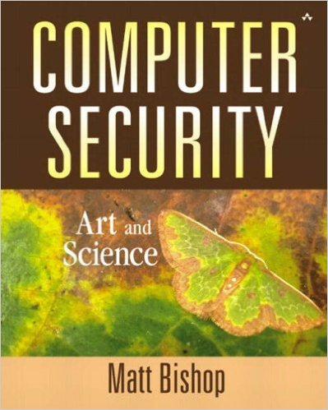
Required Textbook
Computer Security: Art & Science
Author: Matt Bishop
URL’s are in the Syllabus
Get online (don’t wait for bookstore, they may take some time)
Required; and you need your own copy; rent/used OK
ISBN-13: 078-5342440997; ISBN-10: 0201440997
Readings will be assigned starting in a week

Slide 5
Attendance
Attendance is required
If you miss something, it’s up to you to make it up
We will not give quizzes, but if you miss the start of an in-class assignment (which becomes a HW), you need to get with the TA and/or Canvas to make it up
Makeup tests only with specific medical excuses
All absences are to be excused
If you are really sick (vs. hung over), we don’t want you to come to class ☺ we understand

Slide 6
Overview of Syllabus
Main points covered
Review and bring further questions on Wednesday

Slide 7
Format
Usually 2 lectures per week (Dr. Skjellum, guest, etc)
Third period during the week will be
Class assignment, finish at home as HW (8)
Exams/tests (4)
2 tests will be closed book and notes, one TBD, 4th take home and open as of now
Final will be comprehensive – part open/closed

Slide 8
Canvas
Primary interface for class materials
Lecture Power Points, notes, and handouts
Syllabus, follow-ups
Announcements
Homework submissions
Grade information
Make sure you have a way to get your announcements through Canvas, we will rely on it 100% to reach out to you.

Slide 9
Points – Undergrads (COMP5370)
4 tests @ 10% each = 40%
Classroom Exercises+HW 2.5% ea X 8 = 20%
Term Project = 20% (Group or individual)
Final Exam = 20%

Slide 10
Points – Grads (COMP6370)
4 tests @ 7.5% each = 30%
Classroom Exercises+HW 2.5% ea X 8 = 20%
Additional HW = 10%
Term Project = 20% (Individual)
Final Exam = 20%

Slide 11
Grading and Curving
Scale: 90+ A, 80-89.9 B, 70-79.9 C, 60-69.9 D, < 60 = F
Grad students, making a C is not a good thing!
Curving in very limited circumstances only, Professor’s discretion!
Promise: Tests with averages of < 75% will be adjusted to 75% linearly (with grads and ugrads curved separately)
Cheating penalties are a minimum of a grade of zero on the assignment plus reporting
Lack of any HW completion means no passing grade– 12/4 is the last time to turn in HW.

Slide 12
Late Homework
10% penalty per day, maximum 50% off (weekends count as one day)
All HW must be done
Last submission is 12/4/15 @ 11:55pm central time zone

Slide 13
Academic Honesty
You are adults, we trust you – but we verify
Plagiarism on work – understand what that means and avoid it
Tests are always by yourself – proctors will take up tests if there is suspected cheating – consequences can be severe!
Some work is allowed in groups; it will be spelled out!
See syllabus and Auburn standard handbooks
ask Professor Skjellum Questions if you’re not sure (before not after you make a choice)

Slide 14
Special Situations
Accommodations – meet Professor Skjellum
Excused absences – see syllabus
Makeup tests- only with excused absences
Early or late final exams – only for extreme circumstances

Slide 15
Course Objectives
Recognize potential risks and threats to computer operations and communications.
Understand the fundamental terminology and concepts.
Understand Federal rules and regulations affecting computer security, including legal ramifications, FOIA, and policies.
Understand security issues unique to wireless communications.
Have a working knowledge of relevant cryptographic techniques.

Slide 16
Course Objectives, 2
Have a critical understanding of computer security with an emphasis on “end-to-end vulnerabilities.”
Ability to work with crypto keys and effect secure transmissions.
Understanding the ISO OSI Reference Model and how security fits with it, as well as relevant IETF standards.
Understand recent Internet vulnerabilities and their sources (e.g., Logjam and Poodle).

Slide 17
Competencies as a Comp Scientist / Software Engineer
Confident use of Git/Github and GPG/PGP in regards document transmission and secure e-mail communication.
Basic programming competencies related to these topics and this overall subject (e.g., in Java, C/C++, python and/or Perl).
Ability to explain protocols, security, attacks, and possible flaws (e.g., man-in-the-middle attacks) in terms understandable to others in your organization (e.g., a manager making a key decision on a new system)

Slide 18
Meta Learning Objectives
You know enough about computer security and network security to be able to learn more on your own and keep up with the field as it evolves.
You understand how to evaluate computer systems and networks for basic properties of security and in-security/
You can continue on a path to a senior-level of understanding and skill through continued formal and self-study in the field
You won’t get fooled by phish, spam, social engineering attacks, or similar threats!

Slide 19
Use of Technology in Class
You are adults, we treat you like adults – make good choices
Use technology to enhance your learning experience
Look things up
Explore more details
Add new perspectives into a discussion
Help the professor if he gets stuck ☺
As long as you don’t distract others, and don’t interfere with the class, we won’t stop you from using your technology
Tests are always free of all devices, of course!

Slide 20
Term Project
Professor Skjellum will go over in detail on Wednesday
Please read the syllabus info on this by classtime Wednesday

Slide 21
Calibration Exercise - Required
Enter your full name
Do on your own, closed everything but your mind
Answer the questions you know ☺
Leave rest blank – no harml guessing OK, say so if you do please!
This is to baseline to find out what you know (not to embarrass you)
We will compare with your learning at the end of the semester
Helps us evaluate the level of the class starting too.
Non-graded learning tool.

